Slide 1
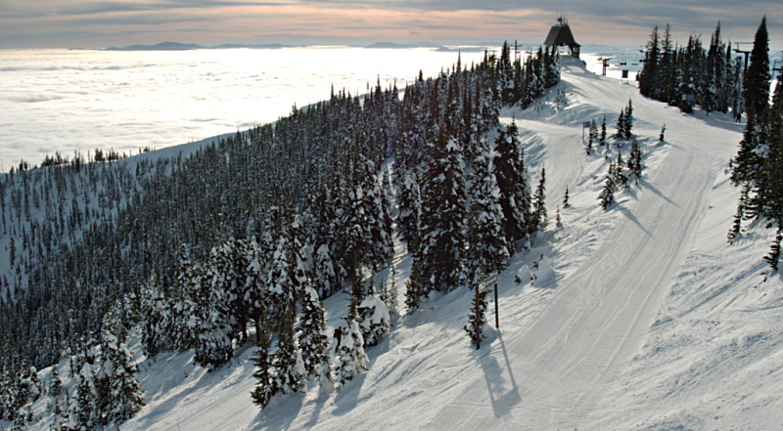
Whitefish Mountain – Maintaining Profits while Expenses Rise
Examining opportunities to keep profit level at 9.2% with increased expense of $1,540,000 from adding new lift.

Slide 2
RECOMMENDATION
Set Adult Weekend Chairlift Ticket to $88
Based on modeling of over 300 ski resorts
Increase of $7 per ticket

Slide 3
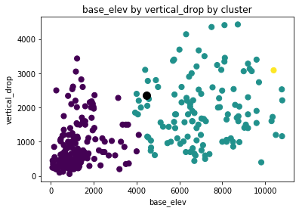
Modeling Results and Analysis
Based on 330 ski resorts throughout the United States
Included details such as number and types of lifts, number of runs, night skiing, average snowfall and snow making acreage
Resorts were first grouped into 3
clusters around base elevation
and vertical drop

Slide 4
Modeling Results and Analysis (continued)
Original data was randomly divided into two groups:
75% to be used as input for model creation
25% as tests of the derived model
Missing data in the following columns were set to zeroes
fastEight (166 entries) NightSkiing_ac (143) TerrainParks (51) SnowMaking_ac (46)
Missing data in the following columns were set to the average of the column:
AdultWeekday (54) AdultWeekend(51) daysOpenLastYear(51) projectedDaysOpen (47) averageSnowfall (14)
LongestRun_mi (5) Runs (4) SkiableTerrain_ac (3) yearsOpen (1)
Only data anomaly was for one resort which was listed as open for 2019 years and was changed to 1
The final model was run without
State – replacing with individual yes/no variables for each state resulted in an out of proportion impact on the model and is not a variable that allows management
Summit_elev and base_elev – these are highly correlated to the vertical_drop variable which was left in the model

Slide 5
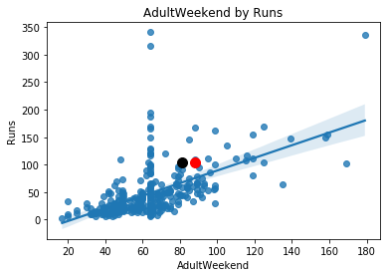
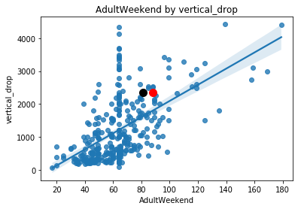
Modeling Results and Analysis (continued)
Vertical_drop and runs were among the most influential inputs to the model, here they are plotted against AdultWeekend
(black dot represents current lift ticket of $81, red represents model proposal of $88)

Slide 6
Conclusion
Since the AdultWeekend and AdultWeekday are highly correlated, both should probably be changed to $88
Based on an estimate of 350,000 visitors per year, this should result in increased revenue of $2,450,000, which would exceed the 9.2% profit goal

